Slide 1

How much is childcare?

Slide 2

Elevator Pitch
Median household income
Median Cost of Childcare
Percentage of income per household
TN and US
2018 and 2023

Slide 3
Median Household Comparisons
2018
2023
US Median - $59,800
Greatest - $83,200 (Maryland)
Least - $44,100 (West Virginia)
State of Tennessee - $52,400
US Median - $70,470
17.84% increase
Greatest - $ 91,035 (Massachusetts)
Least – $56,250 (Mississippi)
State of Tennessee - $65,730
25.44% increase

Slide 4
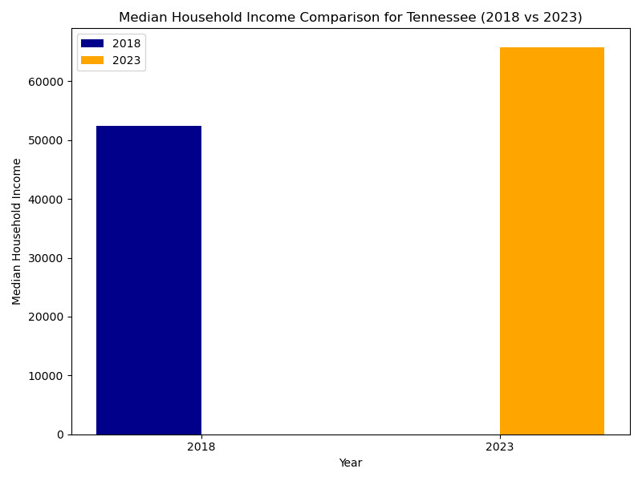
Income Comparison

Slide 5
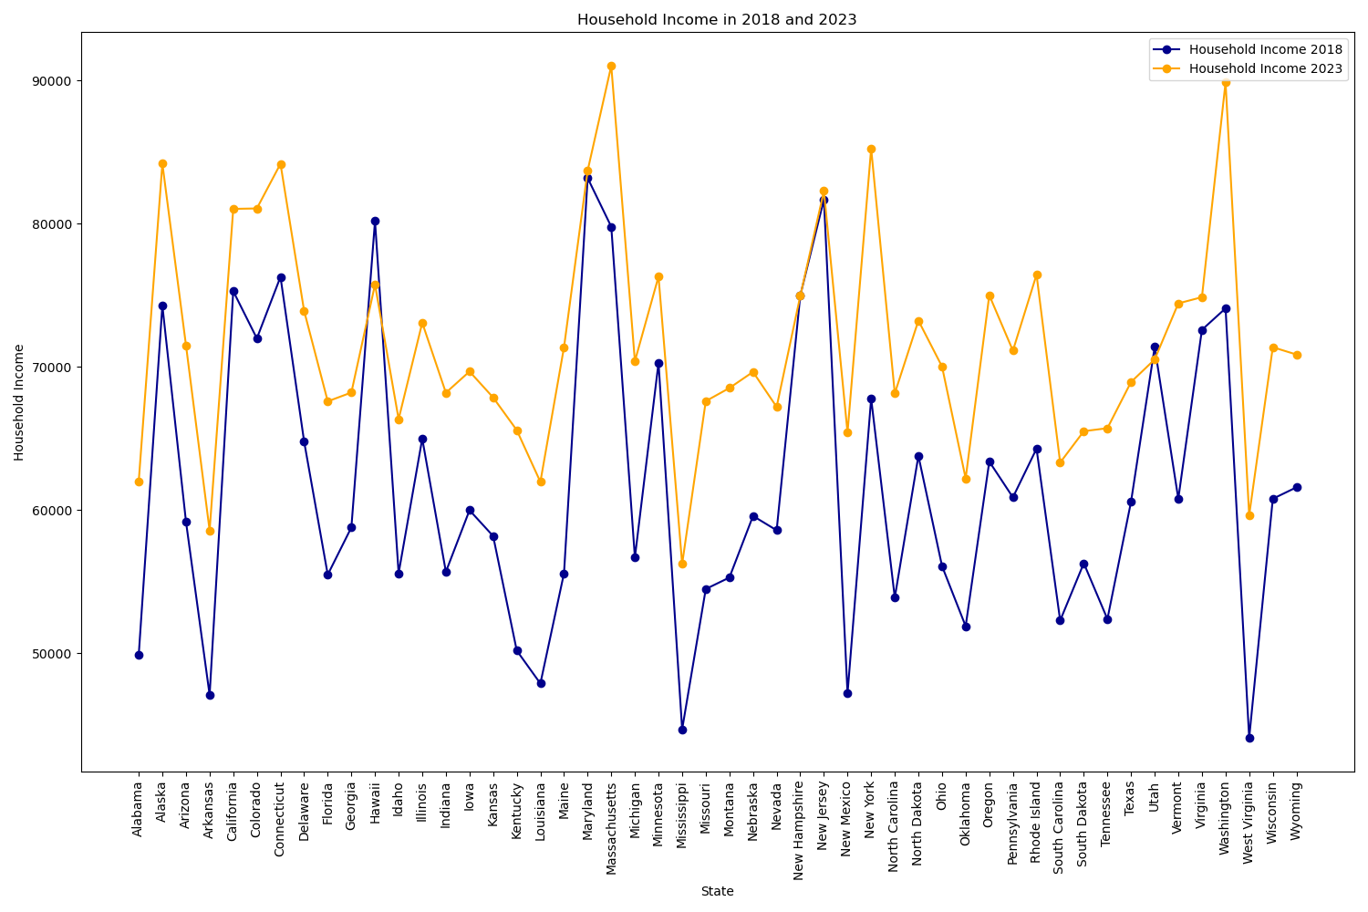
Median Household Income

Slide 6

Cost Of Childcare
Center-based 2018- $7,113-TN $9,094-US
Home-based 2018- $6,005-TN $6,861- US
Center-based 2023- $8,372-TN $10,704-US
Home-based 2023- $7,065- TN $8,076-US

Slide 7
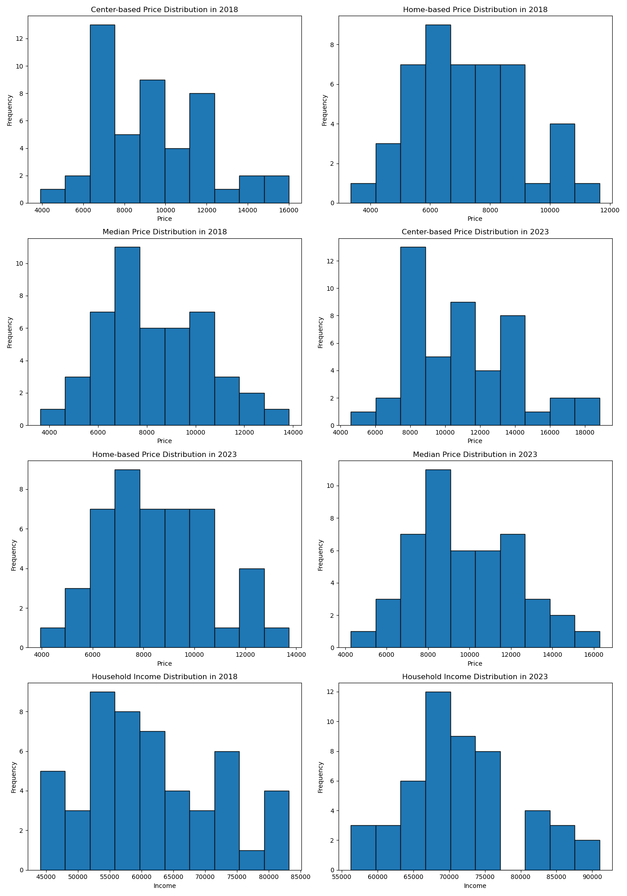
Price Distribution

Slide 8
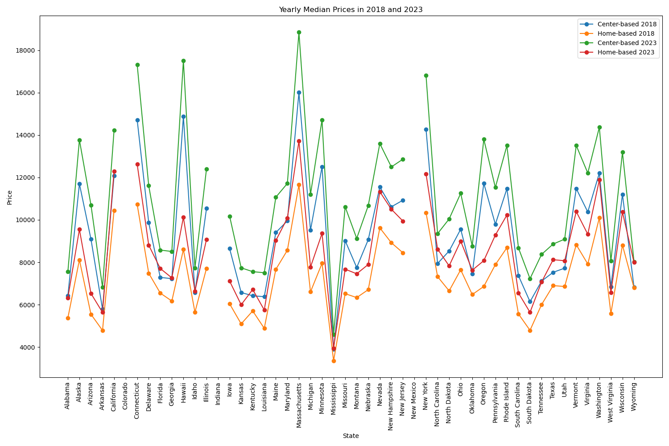
Yearly Median Prices

Slide 9

Cost per child per household
Median Cost per child 2018- $6,550-TN $7,889-US
Median Cost per child 2023- $7,720-TN $9,285-US
Percentage increase in TN- 17.9%
Percentage increase in US- 17.7%
Percentage of income per child 2018- 12.5%
Percentage of income per child 2023- 11.7%

Slide 10
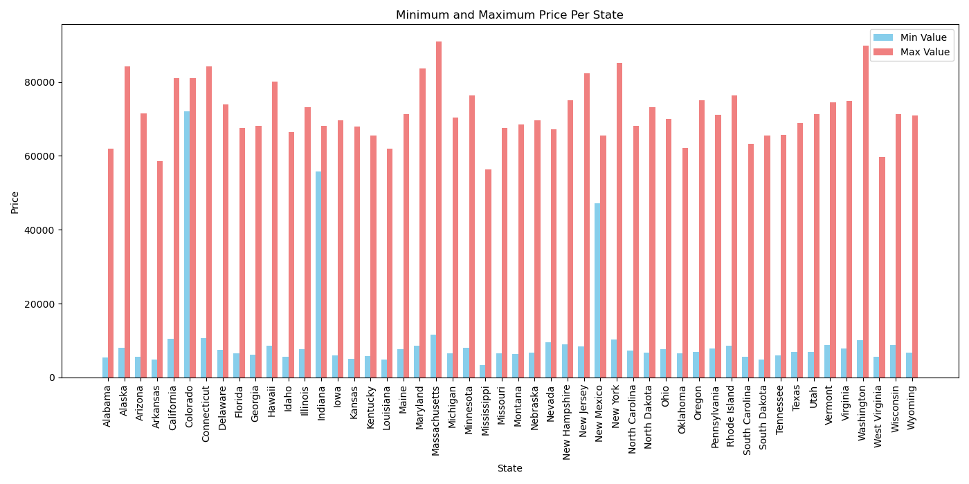
Min-Max Prices Per State

Slide 11
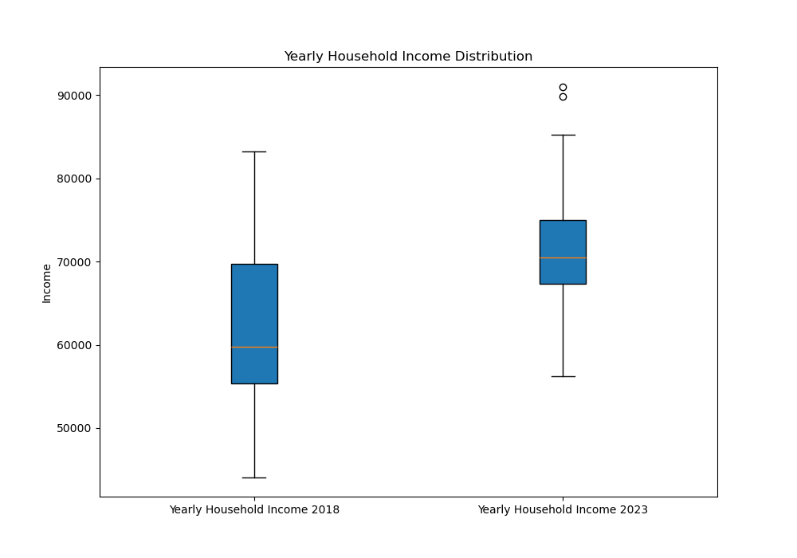
Household Income Distribution

Slide 12
Data Limitations
Incomplete Data
Data sets included numerical data for 2018 but were missing key 2023 figures
Multiple Data Sets
Cross-referencing sources can induce data-reliability concerns
Accuracy
Incomplete data resulted in our group making projections to fully compare time periods

Slide 13
That’s a wrap!
Miss vs Mass
TN vs US- income, childcare, percent increase
Pre-covid and Post-covid
Inflation vs Pandemic
Thoughts for prospective parents

Slide 14

The Sources
Department of Labor- (Childcare info)
https://www.dol.gov/sites/dolgov/files/WB/media/NDCP-State-Level-Estimates-2018-2023.xlsx
Self inc. analysis of childcare by state-(Source of Inspiration)
https://www.self.inc/info/childcare-costs-by-state/#:~:text=Key%20Statistics,%2418%2C866%20per%20child%20per%20year
National Center of Education Statistics- (Median Household Income)
https://nces.ed.gov/programs/digest/d22/tables/dt22_102.30.asp
Census API-
https://www.census.gov/data.html

Slide 15

That’s all folks!

